Slide 1
PROJECTS APPROVED BY THE CSR COMMITTEE FOR
FY 2024-25

Slide 2
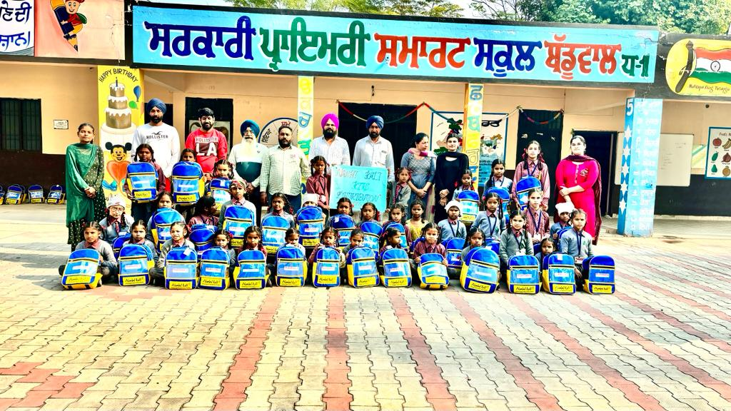
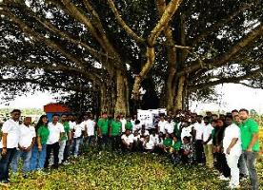
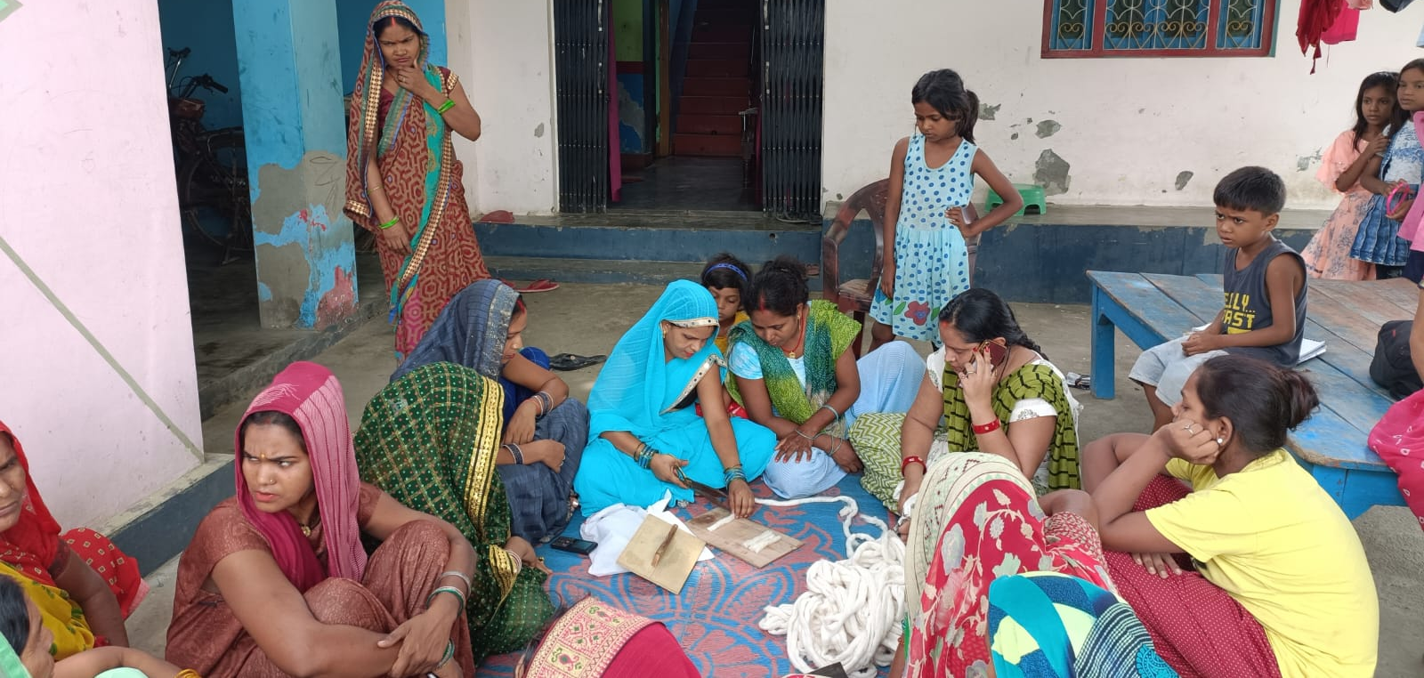
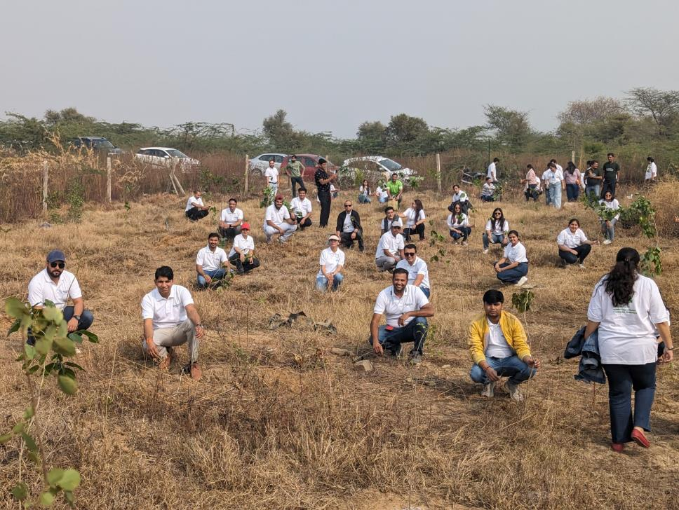
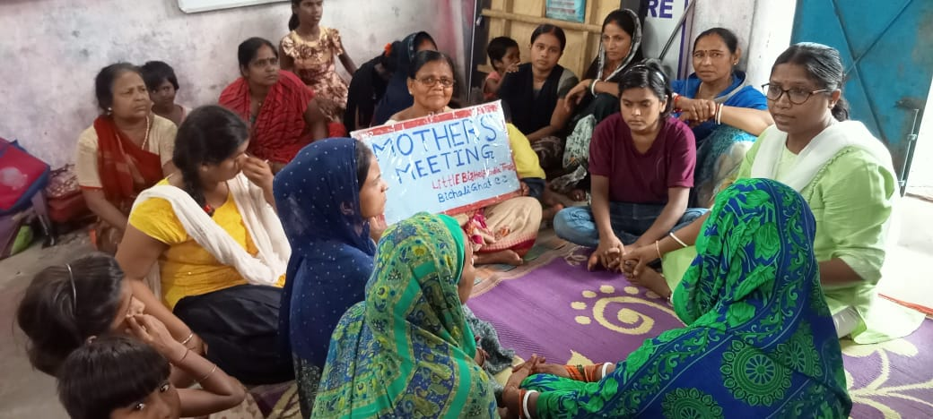
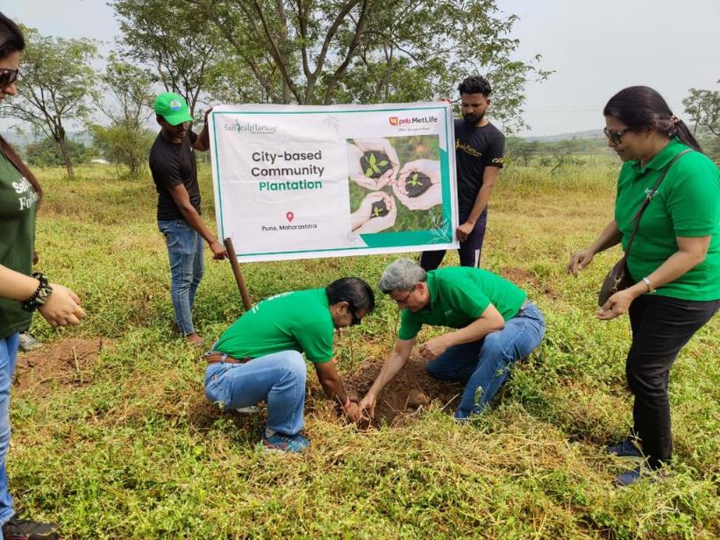
CSR ACTIVITIES OF PNB METLIFE
Empowering Lives, Sustaining Smiles
Empowering the journey of a girl to woman and building a confident tomorrow
Damini
Green Glow
Committing to environmental sustainability and community-led change

Slide 3
CSR PROJECTS UNDER DAMINI
FY 2024-25
1
PROJECT | GIRL CHILD EDUCATION
Locations | Moga (Punjab), Varanasi (Uttar Pradesh)
Objective of the Project | Support the education of underprivileged girls and incorporate them into formal schooling
Name of the Partner NGO | Nanhi Kali - KC Mahindra Education Trust
Number of Beneficiaries | 834 underprivileged girls from Class VI to Class X
2
PROJECT | LIVELIHOOD TRAINING & EMPOWERMENT TO UNDERPRIVILGED WOMEN
Location | Gorakhpur and Varanasi (Uttar Pradesh)
Objective of the Project | Provide livelihood training to underprivileged women and empower them to become financially independent by providing market linkages for their livelihood produces
Name of the Partner NGO | Drishtee Foundation
Number of Beneficiaries | 3000 underprivileged women

Slide 4
CSR PROJECTS UNDER DAMINI
FY 2024-25
3
PROJECT | AWARENESS ON HEALTH AND HYGIENE AMONG ADOLESCHENT GIRLS
Location | Kolkata (West Bengal)
Objective of the Project | Spread awareness on menstrual health among adolescent girls and educate them to maintain good menstrual health through various training programs, distribute menstrual hygiene kits
Name of the Partner NGO | LittleBigHelp
Number of Beneficiaries | 800 underprivileged adolescent girls
PROJECT | AWARENESS ON HEALTH AND HYGIENE AMONG ADOLESCHENT GIRLS
Location | Purulia, Kolkata (West Bengal)
Objective of the Project | Spread awareness on menstrual health among adolescent girls and educate them to maintain good menstrual health through various training programs, distribute menstrual hygiene kits
Name of the Partner NGO | CESR
Number of Beneficiaries | 1400 Tribal underprivileged adolescent girls
4
PROJECT | PROMOTING HEALTH, HYGIENE & SUSTAINABILITY
Location | Gurgaon (Haryana)
Objective of the Project | Awareness on safe drinking water, sanitation, and hygiene (WaSH), construction of rainwater harvesting and promoting solid waste management practices
Name of the Partner NGO | Navjyoti Foundation
Number of Beneficiaries | 450 school children
5

Slide 5
CSR PROJECTS UNDER GLOW GREEN
FY 2024-25
PROJECT | TREE PLANTATION AT ECO SENSTIVE AREAS TO REVIVE NATURAL ECOSYSTEM
Location | Gurugram, Delhi, Pune, Kolkata, Lucknow, Agra, Hyderabad, Anantapur, Bangalore, Chennai and Theog Tehsil (Himachal Pradesh)
Objective of the Project | Create a sustainable ecosystem through long term engagement of the communities in growing and nurturing of trees. 4500 trees to be planted in this financial year
Name of the Partner NGO | SankalpTaru
Number of Beneficiaries | Farmers, Communities, Environment
1
2
PROJECT | CONTROLLING CROP RESIDUE BURNING IN HARYANA
Location | Jind, Haryana
Objective of the Project | Reduce active fire locations, monitor them through awareness sessions for farmer community, Enable stubble management for bailing, stubble collection and disposal
Name of the Partner NGO | Foundation for Development Initiative
Number of Beneficiaries | 2000 Farmers across 20-25 Villages

